Slide 1
RAD Resident Rights Training

Slide 2
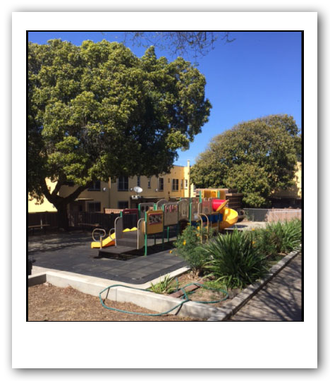
Why RAD?
The Problem
  Converting through the RAD program will allow us to borrow funds when we need to do major renovations.
What is RAD?
  Rental Assistance Demonstration
  RAD was created in 2011 to preserve this critical stock of affordable housing.
  Public housing authorities around the country have used RAD to preserved and improve public housing by “converting” properties to a long-term Project-Based Section 8 contract
  Property changes might include:
    Property renovation with minimal disruption (i.e. residents remain in their units)
    Major property renovation which may include temporary relocation
    Demolition of property which would require permanent relocation for residents to another affordable housing property
    No rehab of property at time of conversion

Slide 3
RAD Core Principles
RAD is designed to secure the long-term affordability of converting properties
Long-term Section 8 HAP contract ensures residents pay an affordable rent and must be renewed at each expiration
RAD Use Agreement recorded on land
Capital Needs Assessment performed upfront to ensure current and future repairs can be supported
One-for-one replacement of deeply affordable units (with de minimis exception)
Properties converted under RAD must be owned or controlled by a public or non-profit owner
In most RAD conversions, the PHA continues to own the property directly or through an affiliate
When Low-Income Housing Tax Credits are used, the ownership changes but a public or non-profit must retain control

Slide 4
RAD Core Principles
Ensure current residents benefit from the conversion
Resident meetings and notices
Right to Remain in or return to the property
No Rescreening as a result of RAD
Relocation assistance
Retain and Strengthen Resident Rights
Ongoing right to organize and resident participation funding
Carry over public housing procedural rights regarding grievance and termination
“Choice-mobility” option to request a tenant-based voucher

Slide 5
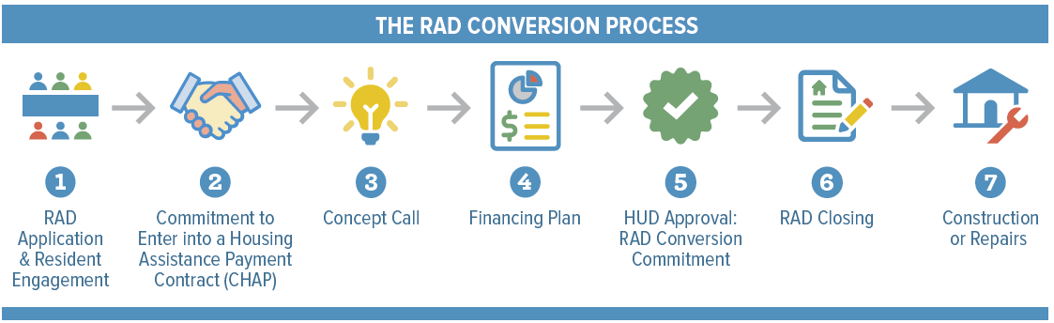
We are here

Slide 6

Resident Engagement

Slide 7
Resident Meetings
The public housing authority must meet with residents of the property multiple times prior to conversion
Prior to applying to HUD, the PHA must meet hold at least two resident meetings
Prior to submitting a Financing Plan, the PHA must meet with residents at least two more times
The purpose of the meetings is to provide you information on the proposal, to collect feedback from residents, and to respond to your questions.

Slide 8
Resident Notices
Prior to applying to HUD, the PHA must provided notices to residents:
  RAD Information Notice, providing you an overview of RAD and your rights
  “General Information Notice” alerting you that you would have the right to relocation assistance if temporary relocation is needed
After HUD approves, the Financing Plan, the PHA must send a notice to all residents
Prior to beginning any relocation, each resident must receive advanced notice of relocation

Slide 9
PHA Plan
Participation in RAD requires a significant amendment to the PHA Plan
The PHA Plan must include a description of the conversion and changes that are proposed
Amending the PHA Plan requires consultation with the Resident Advisory Board and a public hearing and inviting comment around the Plan

Slide 10


Slide 11

Resident rights

Slide 12
Right to Remain and Right of Return
Most conversions do not involve relocation
Residents will remain in place and cannot be rescreened when admitted into the Section 8 program
When relocation is necessary
Residents have a right of return to a unit in the project
No resident may be permanently, involuntarily displaced

Slide 13
No Rescreening
A conversion under RAD cannot be the basis for an eviction or loss of rental assistance
Residents may not be rescreened as a result of the RAD conversion. This includes screening for income, criminal background, and credit.
Following conversion, residents will be protected by standard Section 8 requirements related to tenancy.

Slide 14
Relocation
Where relocation is necessary, PHAs must provide residents with:
Resident notices
Moving assistance
Benefits and assistance per the “Uniform Relocation Assistance and Real Property Acquisition Policies Act (URA)”
Relocation cannot begin until HUD approves the Financing Plan and issues the RAD Conversion Commitment (RCC).
PHAs should maintain a resident log for all impacted residents, which should be provided to HUD
upon request.

Slide 15
Alternative Housing Options
To maximize resident choice, PHAs may offer alternative housing options, such as vouchers, homeownership opportunities, etc.
Residents can voluntarily decline their right to return. Written consent by resident must be:
Informed – written notification with counseling
Voluntary – cannot be pressured and must be provided at least 30 days to decide
Documented – retain evidence of notices, counseling, and resident’s decision

Slide 16
Post-Conversion Resident Rents
Resident rents remain affordable after conversion
Under the Section 8 programs, residents pay 30% of their adjusted gross income in rent. This is mostly true for public housing residents except those paying a “flat rent.”
If tenant rent would increase by more than the greater of 10% or $25 per month, the rent increase will be phased in over 3 or 5 years.

Slide 17
Resident Self-Sufficiency Programs
Residents can continue to participate in self-sufficiency programs the PHA may be operating, including:
Family Self-Sufficiency (FSS). Will continue at least through current grant period.
Resident Opportunities for Self-Sufficiency (ROSS). Will continue through current grant period.
Earned Income Disregard (EID). Enrolled residents can continue to benefit.
Jobs Plus. Residents enrolled in the EID component of Jobs Plus will continue to be eligible post-conversion. All residents can continue to utilize services created as a result of the program.

Slide 18
Section 3 and RAD
Any rehab or construction performed as part of a RAD conversion is subject to Section 3 low-income hiring and contracting requirements.
PHAs must take proactive steps to hire local low-income persons and to award contracts to businesses that are owned by or substantially employ those persons.
Preference for hiring opportunities is provided to public housing and Section 8 residents.

Slide 19
Resident Procedural Rights
Resident organizing rights (24 CFR Part 245) safeguard:
    Formation of resident organizations
    Organizing activities
    Meeting space
    Resident organizers
    Canvassing
Resident participation funding ($25 per unit per year)
Grievance and termination procedures consistent with public housing requirements
Rights must be incorporated into resident lease

Slide 20
Choice-Mobility
Following conversion, residents may request a tenant-based voucher after a period of residency at the converted property (“choice-mobility”), except for certain conversions where the PHA does not have a voucher program.
This is a voluntary option for RAD residents that is not available to Public Housing residents.
Prior to closing, the PHA must notify residents of opportunities and procedures to exercise the choice-mobility option.
For PBV, the resident may request a voucher after one year of residency.
For PBRA, the resident may request a voucher after two years of residency and the PHA/owner may adopt certain other limitations on use. In some cases, HUD may approve a good-cause exemption.
This right must be included in the lease.

Slide 21
Recommendations
Review Notices for information about the RAD process
01
Attend Resident Meetings
02
Ask questions
03
Request clarification or more information before signing documents
04
Indicate if you need additional assistance
05

Slide 22
Questions/Issues?
Typically, the best place to start when you have questions or issues related to the RAD conversion is to discuss with your property manager.
For additional assistance, see below.
Prior to Conversion
Public Housing Lease
HUD Public Housing Field Office
Project Based Voucher Lease
BangorHousing
HUD Public Housing Field Office
After Conversion
Project Based Rental Assistance Lease
HUD Multifamily Field Office
Public Housing Field Offices: www.hud.gov/program_offices/public_indian_housing/about/field_office
Multifamily Field Offices: www.hud.gov/program_offices/housing/mfh/hsgmfbus/abouthubspcs

Slide 23
Thank You and Questions
For more information visit: www.hud.gov/rad
Contact: (insert property manager/PHA contact info) rad@hud.gov
Join the RAD LISTSERV for periodic news and updates
(link available at the bottom right of the www.hud.gov/rad webpage)

Slide 24
PHA Specific Conversion Plans
(input PHA specific conversion plans including timeline and relocation plan if applicable)

